Slide 1
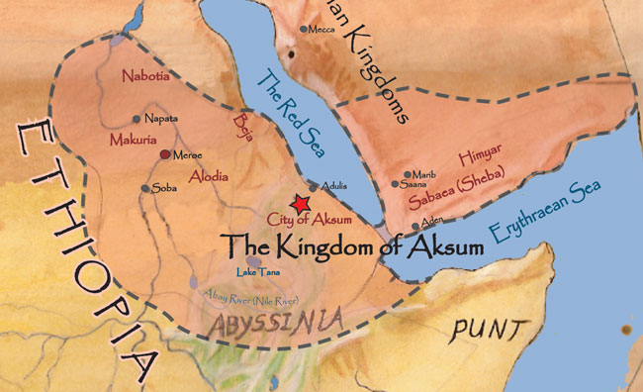
Kingdoms and Trading States of East Africa
Axum (Aksum):
Center of Goods and Ideas
Commanded triangular trade network connecting Africa, India & The Mediterranean
Sold Variety of Goods: Slaves, Ivory, Spices, animal hides, gold, precious stones, cotton cloth, etc.

Slide 2
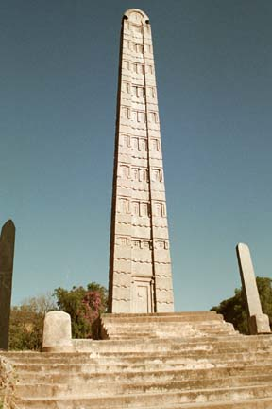
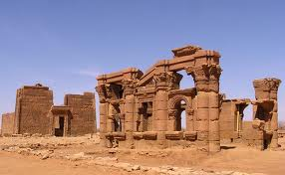
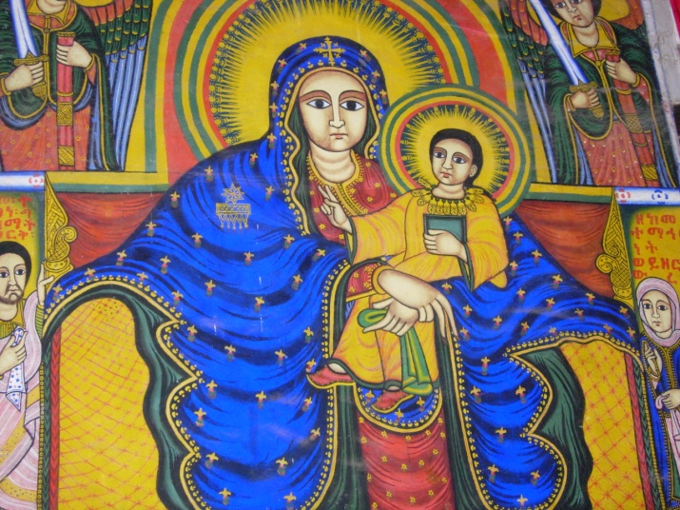
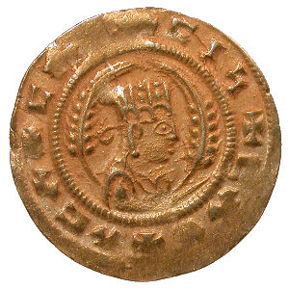
Aksum- cont.
300s Christianity reached region
King Ezana made Christianity official religion
600s Islam began spreading, N. African rulers embraced it
Aksum was the lone Christian outpost, eventually weakened, declined

Slide 3
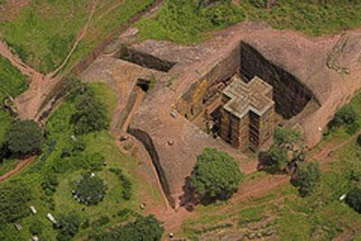
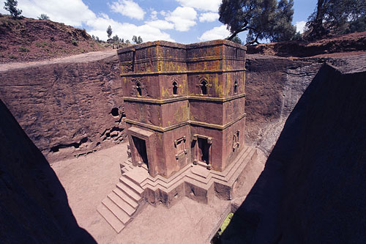
Ethiopia: A Christian Outpost
Descendents of Axum settled here
Unified by Christian Faith
Kept ties with Holy Land
Churches built by King Lalibela were carved from ground level downward into solid rock!
Kings claimed descent from Israelite King Solomon& Queen of Sheba
Observe some Jewish holidays & dietary laws
Some practiced Judaism, not Christianity
1900s Jews moved to Israel – escape famine & persecution

Slide 4
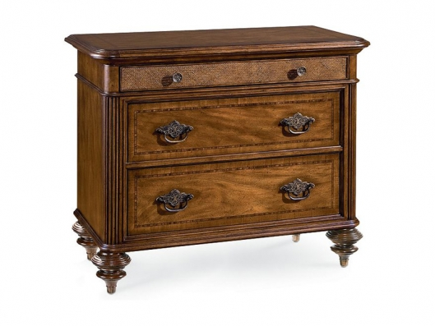
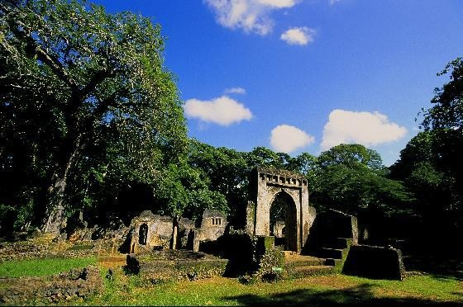
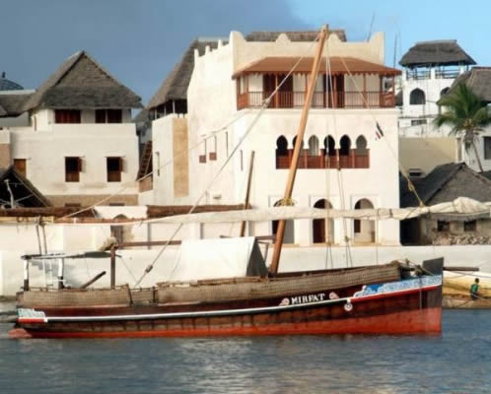
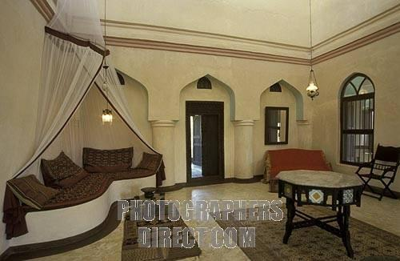
East African trade system brought traders from Middle East & Asia
Developed new culture & language = Swahili
Arabic language + Bantu language = Swahili
Swahili means “of the coast”
Unique houses & furniture
Antique Swahili furniture
Ancient Swahili ruins
Swahili style home on the coast of Africa
Antique Swahili furniture

Slide 5
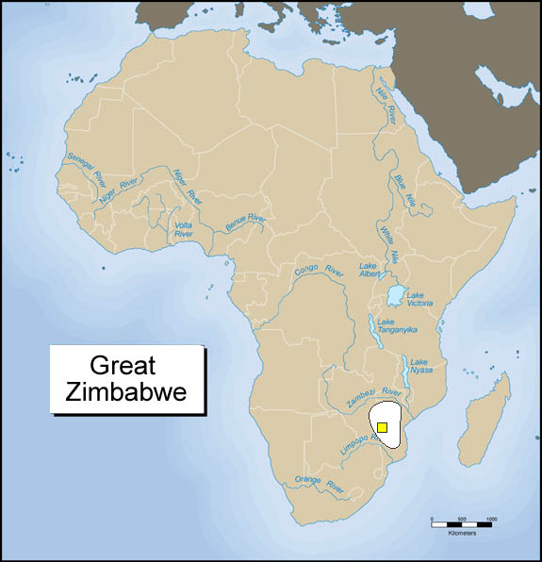
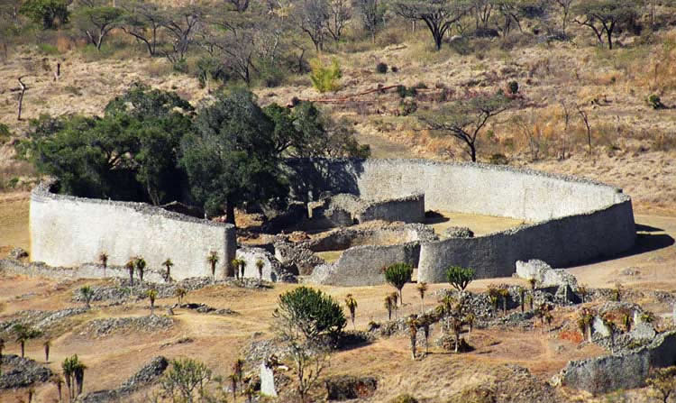
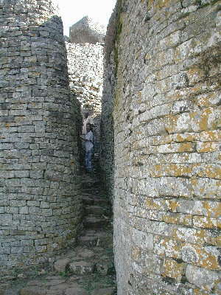
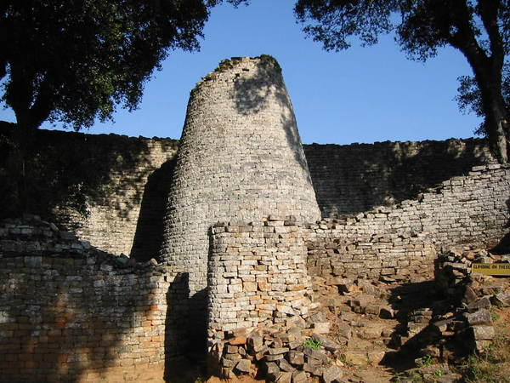
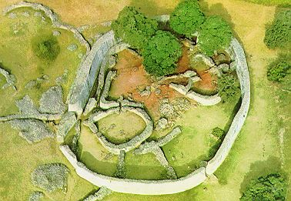
Great Zimbabwe
Zimbabwe means “stone houses” in Bantu
Not much is known about the people and the culture of Great Zimbabwe.
This is due to the fact that they had no written language and the oral traditions have not survived.
What we do know is that they left behind the Great Zimbabwe ruins.
Artifacts show they traded with India and China

